Slide 1
ADAPTIVE MAIL: A FLEXIBLE EMAIL CLIENT APP
NILANI.R
TEAM MEMBERS
ABINAYA DOLPHIN.S
AKASH.S
JACOB.A

Slide 2
Description:
Intelligent Sorting: Prioritize your inbox with AI-driven sorting that categorizes emails based on importance, urgency, and relevance.
Customizable Interface: Tailor your email dashboard with customizable themes, layouts, and widgets to enhance your productivity and suit your personal style.
Seamless Integration: Connect with your favorite apps and services, from calendar tools to cloud storage, ensuring a seamless workflow.
Smart Filters: Create and automate filters to manage your emails effortlessly, reducing the time spent on repetitive tasks.
Security First: Advanced encryption and privacy features ensure your communications are always secure and confidential.

Slide 3
Main Activity.java:
package com.shankarlohar.flashnews.activities
import android.os.Bundle
import androidx.activity.ComponentActivity
import androidx.activity.compose.setContent
import androidx.compose.foundation.isSystemInDarkTheme
import androidx.compose.foundation.layout.fillMaxSize
import androidx.compose.material.MaterialTheme
import androidx.compose.material.Surface
import androidx.compose.runtime.Composable
import androidx.compose.ui.Modifier
import androidx.compose.ui.graphics.Color
import androidx.compose.ui.graphics.toArgb
import androidx.core.view.WindowCompat

Slide 4
import com.shankarlohar.flashnews.states.BaseState
import com.shankarlohar.flashnews.ui.theme.FlashNewsTheme
import com.shankarlohar.flashnews.viewmodels.BaseVM
abstract class BaseActivity<VM : BaseVM<State>, State : BaseState> : ComponentActivity() {
abstract val viewModel: VM
@Composable
abstract fun Content()
final override fun onCreate(savedInstanceState: Bundle?) {
super.onCreate(savedInstanceState)
setContent {
handleSystemBarAndNavigationColor(isSystemInDarkTheme())
FlashNewsTheme() {
Surface(modifier = Modifier.fillMaxSize(), color = MaterialTheme.colors.background) {
Content()
}
}
}
}

Slide 5
private fun handleSystemBarAndNavigationColor(isDarkTheme: Boolean) {
val color = if (isDarkTheme) {
Color(0xFF121212).toArgb()
} else {
Color.White.toArgb()
}
window?.statusBarColor = color
window?.navigationBarColor = color
WindowCompat.getInsetsController(window, window.decorView).apply {
isAppearanceLightNavigationBars = !isDarkTheme
isAppearanceLightStatusBars = !isDarkTheme
}
}
}

Slide 6
package com.shankarlohar.flashnews.activities
import androidx.activity.viewModels
import androidx.compose.runtime.Composable
import com.shankarlohar.flashnews.activities.BaseActivity
import com.shankarlohar.flashnews.states.HomeState
import com.shankarlohar.flashnews.ui.screen.HomeScreen
import com.shankarlohar.flashnews.viewmodels.HomeVM
import dagger.hilt.android.AndroidEntryPoint
@AndroidEntryPoint
class HomeActivity : BaseActivity<HomeVM, HomeState>() {
override val viewModel: HomeVM by viewModels()
@Composable
override fun Content() {
HomeScreen(viewModel)
}
}

Slide 7
Activity_main.xml:
<?xml version="1.0" encoding="utf-8"?>
<manifest xmlns:android="http://schemas.android.com/apk/res/android"
xmlns:tools="http://schemas.android.com/tools">
<uses-permission android:name="android.permission.INTERNET" />
<application
android:name=".App"
android:allowBackup="true"
android:dataExtractionRules="@xml/data_extraction_rules"
android:fullBackupContent="@xml/backup_rules“
android:icon="@mipmap/ic_launcher"
android:label="@string/FlashEmail"
android:roundIcon="@mipmap/ic_launcher_round"
android:supportsRtl="true"
android:theme="@style/Theme.Emailapp"
tools:targetApi="31">

Slide 8
<activity
android:name=".activities.HomeActivity"
android:exported="true"
android:label="@string/Emailapp"
android:theme="@style/Theme.EmailApp">
<intent-filter>
<action android:name="android.intent.action.MAIN" />
<category android:name="android.intent.category.LAUNCHER" />
</intent-filter>
</activity>
</application>
</manifest>

Slide 9
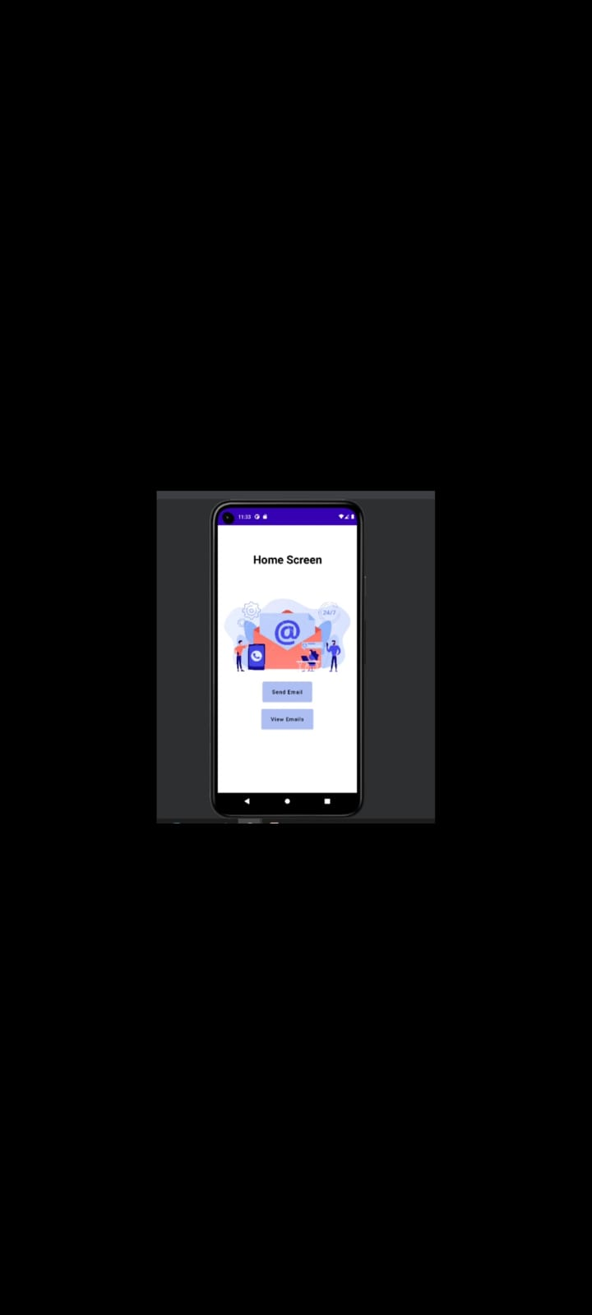
Output:

Slide 10
